Slide 1
Amplified by Design
TikTok's Engagement Logic, Misogynistic Content,
and the Limits of Platform Governance
Iman Ghasempour
Global Challenges in New Media and Management

Slide 2
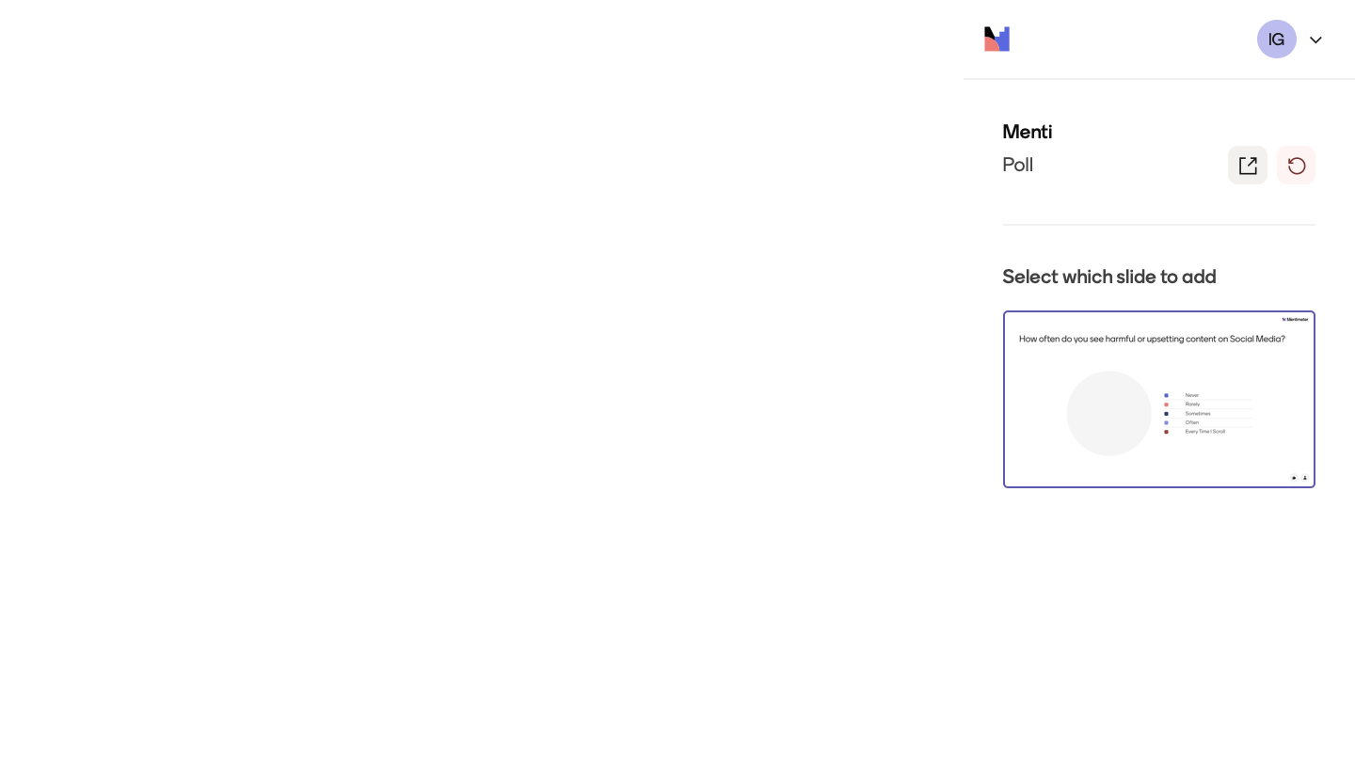

Slide 3
THE ARGUMENT
3 Main Points:
01
The Platform is the Problem
TikTok's engagement-driven business model algorithmically rewards misogynistic content for its capacity to generate interaction — this is a structural outcome, not a moderation failure
02
Governance has Failed
Self-regulation, advertiser pressure, and the DSA all focus on content removal — none challenge the algorithmic and profit logics that make harmful content valuable to circulate
03
Structural Regulation is Necessary
Effective governance requires algorithmic accountability, human rights-based risk assessments, and frameworks that treat misogyny as a structural feature of platform design

Slide 4
THE PROBLEM
A Platform Built to Reward Engagement
1B+
3×
0
Monthly Active Users (2023)
Governance Approaches Tried
Challenges to the Algorithm
One of the world's most powerful communication infrastructures
Self-regulation · advertiser pressure · DSA — all content-focused
None of these responses touch the business logic that amplifies harm

Slide 5
TIKTOK & THE ATTENTION ECONOMY
A Surveillance Machine, Not a Social Platform
The Engagement-to-Revenue Pipeline
Why Misogyny Pays the Algorithm
TikTok monetises through advertising and digital goods — both require maximum time-on-platform
More engagement = more data = more targeted ads = higher revenue
The algorithm optimises for engagement volume — no incentive to distinguish constructive from harmful content
"The user is not the customer; the user is the product"
Misogynistic content generates both support and outrage — both register as engagement
This makes it doubly profitable: it needs a reactive audience, not a sympathetic one
Short-form video privileges emotional provocation, rewarding content designed to trigger responses
The algorithm is indifferent to endorsement or condemnation — it only measures interaction
Fuchs (2024): TikTok is “a surveillance machine that treats user data as a commodity to be exploited for capital accumulation, not democratic communication”

Slide 6
MISOGYNY AS STRUCTURAL OUTCOME
Four Steps from Ideology to Amplification
Right-Wing Authoritarianism
The Manosphere
Algorithmic Oppression
Scale
Militant patriarchy: subordination of women as foundational ideology
Fuchs, 2024
Misogyny repackaged as truth-telling, self-improvement, and anti-feminism
Algorithm biases information toward stereotypic results for marginalized groups — misogynistic content is structurally advantaged
Noble, 2018
Affective homosocial currencies carry misogynistic content to teenage audiences
Haslop et al., 2024

Slide 7
THE CONTENT REGULATION TURN
3 Levels of Governance
01
Platform Self-Regulation
Community standards + account bans produce only a "waterbed effect" — banned users migrate to Telegram/BitChute. The algorithm that amplified them remains untouched. (van Dijck et al., 2024)
02
Advertiser-Driven Governance
GARM standards protect brand safety, not democratic values. They target illegal content only — leaving harmful-but-legal manosphere material within the brand safety floor. (Hill & Shtern, 2024)
03
EU Digital Services Act
Most ambitious attempt — but still content-focused. Restricts speech only where "proportionate". Fails to address why harmful content circulates at scale. (Mansell, 2024; Andrews, 2024)
Hill & Shtern (2024): The content regulation turn "chases an impossibility" — it ignores the structural conditions that make harmful content profitable to circulate.

Slide 8
TOWARDS STRUCTURAL GOVERNANCE
Necessary Shifts in Platform Governance
1
Content → Algorithmic Governance
Mandatory independent auditing of TikTok's recommendation logic. Enforceable obligations to demonstrate engagement-maximization does not structurally advantage harmful content. (Puppis et al., 2024)
2
Market Values → Human Rights
Risk assessments must be measured against democratic communication rights, not legal thresholds. Is the platform's design compatible with "democratic human flourishing"? (Gurumurthy & Chami, 2024)
3
Incidental → Structural Harm
Gender-transformative governance asks whether platform design systematically excludes women from democratic participation. (Padovani et al., 2024; Fuchs, 2024)

Slide 9
REFERENCES
Fuchs, C. (2024). Social Media: A Critical Introduction (4th ed.). SAGE.
Haslop, C., Ringrose, J., Cambazoglu, I., & Milne, B. (2024). Mainstreaming the Manosphere's Misogyny. Social Media + Society, 10(1).
Puppis, M., Mansell, R., & Van Den Bulck, H. (Eds.). (2024). Handbook of Media and Communication Governance. Edward Elgar.
Andrews, L. (2024). Done is better than perfect. In Puppis et al. (2024).
Padovani, C., Wavre, V., Hintz, A., Goggin, G., & Iosifidis, P. (Eds.). (2024). Global Communication Governance at the Crossroads. Springer.
van Dijck, J., de Winkel, T., & Schäfer, M.T. (2024). Deplatforming as Governance Strategies. In Puppis et al. (2024).
Hill, S., & Shtern, J. (2024). Techlash, Platformization and the Struggle to Govern. In Padovani et al. (2024).
European Commission. (2024). Commission opens formal proceedings against TikTok under DSA.

